Slide 1
Image And Video Retrieval System

Slide 2
What is CBIR ?
What is CBVR ?
multimedia techniques
Our project

Slide 3
Content-Based Image Retrieval (CBIR)
also known as query by image content (QBIC)
It is the application of computer vision techniques to the image retrieval problem, that is, the problem of searching for digital images in large database, Images have rich content.
This content can be extracted as various content features:
–Mean color, Color Histogram … etc.
Take the responsibility of forming the query away from the user.
Each image will now be described by its own features.

Slide 4
Content-Based Video Retrieval (CBVR)
Traditional video retrieval methods fail to meet technical challenges due to large and rapid growth of multimedia data.
The amount of lecture video data on the World Wide Web (WWW) is growing rapidly. Therefore, a more efficient method for video retrieval in WWW or within large video archives is urgently needed.
Areas in which CBVR can be used: (Mass media / Forensic / Fingerprint & DNA matching /Surveillance Systems)

Slide 5
how CBVR systems work
Video Parsing: Manipulation of whole video for breakdown into key frames.
Video Indexing: Retrieving information about the video for indexing in a database.
Video Retrieval and browsing: Users access the database through queries or through interactions.

Slide 6
multimedia techniques
Image's techniques
Mean color
Histogram
Color Layout
Video's techniques
Histogram

Slide 7
Image's techniques
Mean color:
This technique depends on computing the distance between images based on the color similarity between them. For RGB images the mean color of pixels is computed by finding the average color of the pixels in each channel separately then finding the average between the three values that result from each channel.
To get the most similar images to the input image ,the difference between the mean color the input image and each image in the database is computed then we apply a reasonable threshold to exclude the images with large distance.

Slide 8
Image's techniques
Histogram
A histogram is a graphical representation that organizes a group of data points into user-specified ranges. Similar in appearance to a bar graph , the histogram condenses a data series into an easily interpreted visual by taking many data points and grouping them into logical ranges or bins.

Slide 9
Image's techniques
Color Layout
This technique is like histogram-based technique except it solves the problem of getting results of images with a low histogram distance value but with a different contents.
Divide whole image into sub-blocks then Extract features from each sub-block, divide into regions based on color feature concentration.

Slide 10
Example: Color layout

Slide 11
Video's techniques
Histogram
we convert the video into a group of images, every image is keyframe where keyframe is a frame where we define changes in animation. Take the video and return it’s keyframes then we deal with keyframe as image and read it then in data base we store video as keyframes. and deal with video as group of images and take keyframe by and returns real histogram fer each keyframe.

Slide 12
Our project
project implementation
GUI

Slide 13
project implementation
Image class
Techniques class
Video class
Data Base class
Comparator class

Slide 14
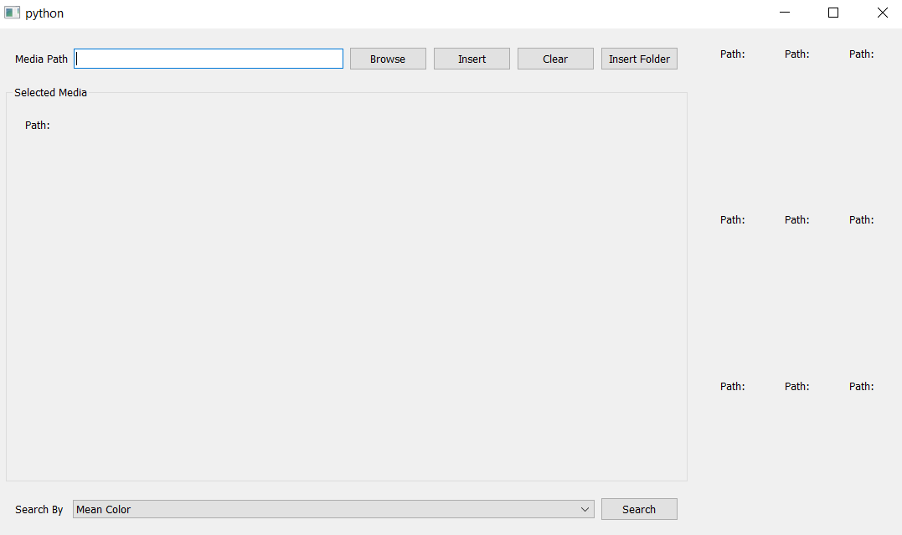
GUI

Slide 15
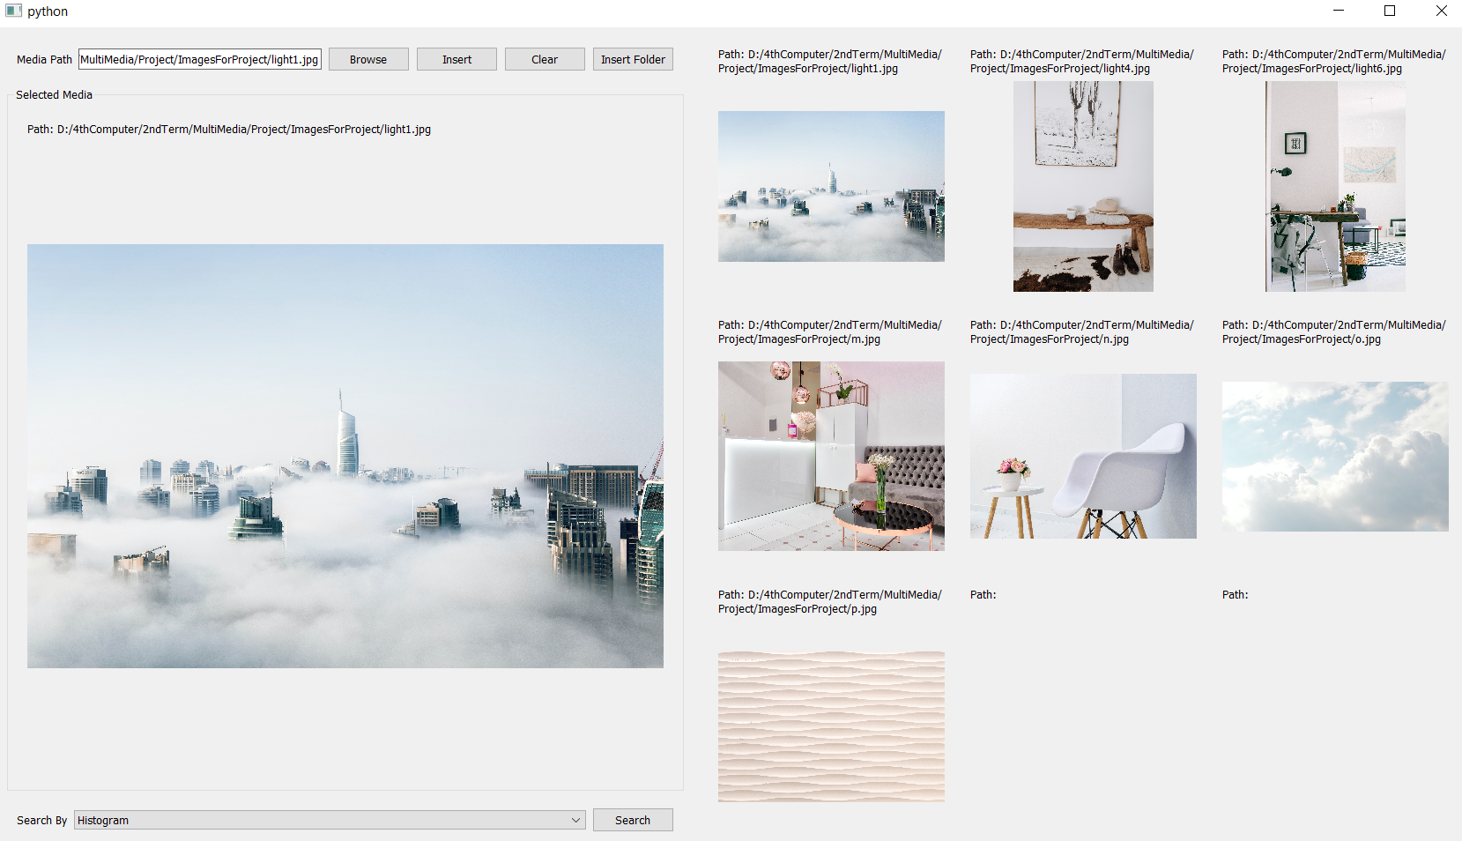
Examples

Slide 16
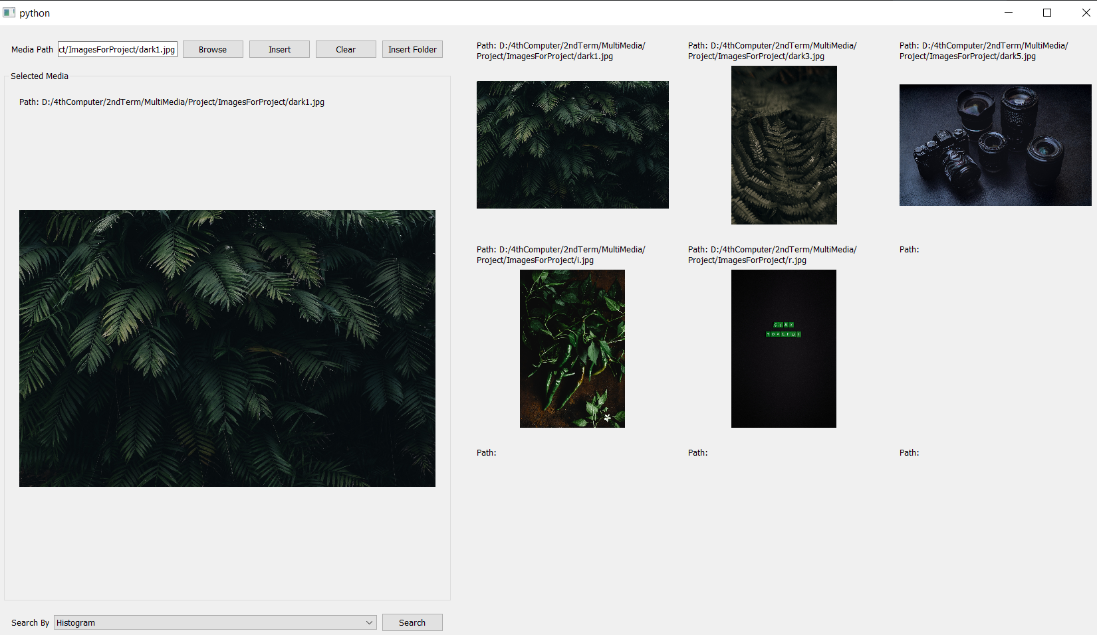
Examples

Slide 17
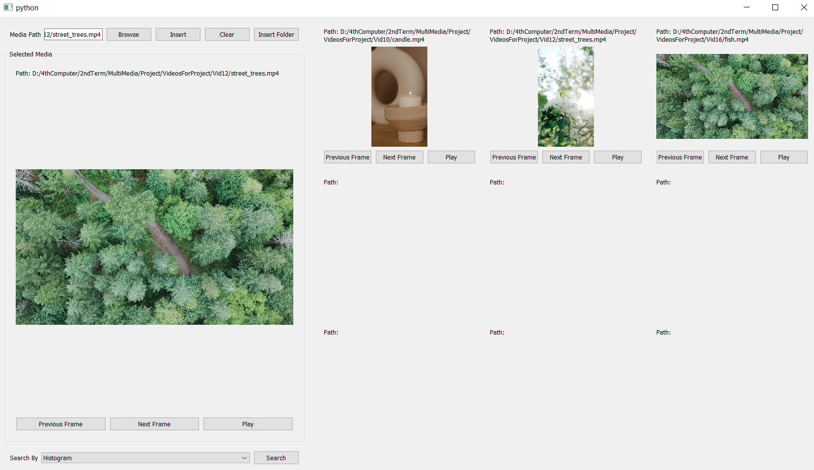
Examples

Slide 18
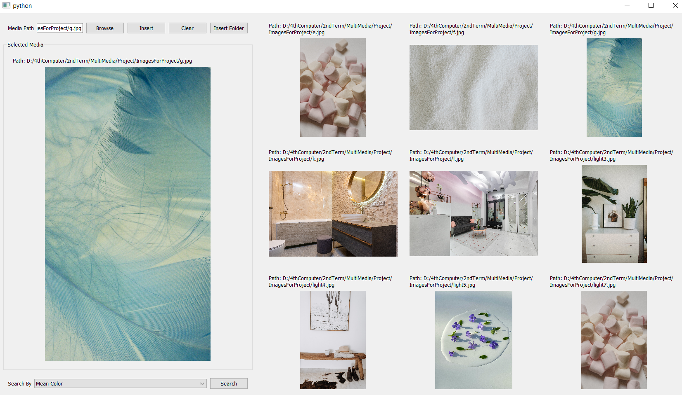
Examples

Slide 19
The END

